Slide 1
FOREIGN DIRECT INVESTMENT IN INDIA, EXPORTS & IMPORTS

Slide 2
Various modes of entry for any foreign entity in India
Place of Business in India
Foreign Company
Indian Company
WOS/Subsidiary
Joint Venture
Branch Office
Project Office
Liaison Office

Slide 3
ENTRY ROUTE - BO/LO/PO
Branch office
any establishment described as such by the company.
Liaison office
place of business to act as channel of communication between Head Office and Indian entities.
does not undertake any commercial/ trading/ industrial activity, directly or indirectly.
maintains itself out of inward remittances received from abroad through normal banking channel.
Project office / Site office
place of business in India to represent interests of a foreign company executing a project in India
Site office is a sub-office of project office established at the site of project
both excludes a liaison office.
Prior approval of RBI for all of the above in most cases except Banking or Insurance company which has obtained approval or in SEZ.
Foreign law firms cannot open Liaison Office or practice in India.

Slide 4
ENTRY ROUTE - BO/LO/PO
The application for establishing BO/LO/PO in India may be submitted by the non-resident entity in Form FNC to a designated AD Category-I bank along with the prescribed documents mentioned in the Form and the LOC, wherever applicable.
A profit making track record during the immediately preceding five/three financial years in the home country and net worth of not less than USD 100,000/ 50,000 or its equivalent is mandatory for branch / liaison office or a Letter of Comfort in prescribed form from its parent/group company.
There is a general permission to non-resident companies to establish POs in India, provided they have secured a contract from an Indian company to execute a project in India.
The Annual Activity Certificate (AAC) as at the end of March 31 each year along with the audited financial statement needs to be submitted before 30th September.
BOs are permitted to remit outside India profit of the branch net of applicable Indian taxes, on production of the specified documents to the satisfaction of the AD Category-I bank through whom the remittance is effected.
A foreign company establishing a place of business in India should submit within 30 days to ROC Copy of balance sheet and P&L account with English translation and list of places of business established by the foreign company in India. Audit of accounts of foreign company shall be conducted by practicing CA.

Slide 5
PERMITTED ACTIVITIES FOR A BRANCH OFFICE / LIAISON OFFICE IN INDIA OF A PERSON RESIDENT OUTSIDE INDIA
Permitted activities for a branch office in India of a person resident outside India
i. Export/import of goods.
ii. Rendering professional or consultancy services.
iii. Carrying out research work in which the parent company is engaged.
iv. Promoting technical or financial collaborations between Indian companies and parent or overseas group company.
v. Representing the parent company in India and acting as buying/selling agent in India.
vi. Rendering services in Information Technology and development of software in India.
vii. Rendering technical support to the products supplied by parent/group companies.
viii. Representing a foreign airline/shipping company.
Permitted activities for a liaison office in India of a person resident outside India
i. Representing the parent company / group companies in India.
ii. Promoting export / import from / to India.
iii. Promoting technical/ financial collaborations between parent / group companies and companies in India.
iv. Acting as a communication channel between the parent company and Indian companies.

Slide 6
Eligible instruments for investment by Person resident outside India
Non-debt Instruments
Debt Instruments
NOTIFICATION NO. S.O. 3732(E) [F.NO.1/14/EM/2015], DATED 17-10-2019
NOTIFICATION NO S.O. 3722(E) [F.NO. 1/14/EM/2015], DATED 16-10-2019
FEM (Non-debt instruments) Rules, 2019
FEM (Debt instruments) Regulations, 2019
FEM (Mode of Payment and Reporting of Non-Debt Instruments) Regulations, 2019

Slide 7
INVESTMENTS BY PERSON RESIDENT OUTSIDE INDIA
A person resident outside India may subscribe, purchase or sell equity instruments of an Indian company in the manner and subject to the specified terms and conditions.
"equity instruments" means equity shares, convertible debentures, preference shares and share warrants issued by an Indian company. Explanation:—
(i) Equity shares shall include partly paid shares. "Convertible debentures" means fully, compulsorily and mandatorily convertible debentures. "Preference shares" means fully, compulsorily and mandatorily convertible preference shares. Share Warrants are those issued in accordance with the regulations by the SEBI. Equity instruments can contain an optionality clause subject to a minimum lock-in period of one year or as prescribed for the specific sector, whichever is higher, but without any option or right to exit at an assured price.
(ii) Partly paid shares shall be fully called-up within twelve months of such issue or as may be specified by the RBI from time to time. Twenty- five per cent of the total consideration amount (including share premium, if any) shall be received upfront.
(iii) In case of share warrants, at least twenty-five per cent of the consideration shall be received upfront and the balance amount within eighteen months of the issuance of share warrants.

Slide 8
INVESTMENTS BY PERSON RESIDENT OUTSIDE INDIA
A person resident outside India may purchase equity instruments of a listed Indian company on a stock exchange in India if the person resident outside India making the investment has already acquired control of such company in accordance with SEBI (Substantial Acquisition of Shares and Takeover) Regulations, 2011 and continues to hold such control. Further the amount of consideration may be paid as per the mode of payment specified by the RBI or out of the dividend payable by Indian investee company in which the person resident outside India has acquired and continues to hold the control in accordance with SEBI (Substantial Acquisition of Shares and Takeover) Regulations, 2011 provided the right to receive dividend is established and the dividend amount has been credited to a specially designated non-interest bearing rupee account for acquisition of shares on the recognised stock exchange.
Equity instruments to a person resident outside India can be issued under following entry routes:-
"automatic route" means the entry route through which investment by a person resident outside India does not require the prior approval of the Reserve Bank or the Central Government;
"government route" means the entry route through which investment by a person resident outside India requires prior Government approval and foreign investment received under this route shall be in accordance with the conditions stipulated by the Government in its approval.

Slide 9
INVESTMENTS BY PERSON RESIDENT OUTSIDE INDIA
Foreign investment is permitted up to one hundred percent on the automatic route subject to applicable laws or regulations, security and other conditionalities except in case of investment in the sectors or activities where Sectoral cap is specified.
Aggregate foreign portfolio investment up to forty-nine percent of the paid-up capital on a fully diluted basis or the sectoral or statutory cap, whichever is lower, shall not require Government approval or compliance of sectoral conditions as the case may be, if such investment does not result in transfer of ownership and control of the resident Indian company from resident Indian citizens or transfer of ownership or control to persons resident outside India and other investments by a person resident outside India shall be subject to the conditions of Government approval and compliance of sectoral conditions as laid down in these rules.
The onus of compliance with the sectoral or statutory caps on such foreign investment and attendant conditions, if any, shall be on the company receiving foreign investment.
Wherever the person resident outside India who has made foreign investment specifies a particular auditor or audit firm having international network for the audit of the Indian investee company, then audit of such investee company shall be carried out as joint audit wherein one of the auditors is not part of the same network.

Slide 10
SECTORAL CAP
SECTOR/ ACTIVITY | Sectoral Cap
Agriculture and Animal Husbandry
(a) Floriculture, Horticulture and Cultivation of vegetables and mushrooms under controlled conditions; (b) Development and production of seeds and planting material; (c) Animal Husbandry (including breeding of dogs), Pisciculture, Aquaculture and Apiculture; and (d) Services related to agro and allied sectors. Note: Other than the above, foreign investment is not allowed in any other agricultural sector or activity. | 100%
Plantation
(a) Tea sector including tea plantations (b) Coffee plantations (c) Rubber plantations (d) Cardamom plantations (e) Palm oil tree plantations (f) Olive oil tree plantation Note: Foreign investment is not allowed in any plantation sector/ activity other than those listed above. | 100%

Slide 11
SECTORAL CAP
SECTOR/ ACTIVITY | Sectoral Cap
Mining | 100%
Coal and Lignite | 100%
Petroleum and Natural Gas | 100%
Manufacturing A manufacturer is permitted to sell its products manufactured in India through wholesale and/ or retail, including through e-commerce without Government approval. Notwithstanding the provisions of these Rules on trading sector, 100 percent foreign investment under the government approval route is allowed for trading, including through e-commerce, in respect of food products manufactured and/ or produced in India. Applications for foreign investment in food products retail trading shall be processed in the Department of Industrial Policy and Promotion before being considered by the Government for approval. | 100%

Slide 12
PRICING GUIDELINES
The price of equity instruments of an Indian company to a person resident outside shall not be less than:
the price worked out in accordance with the SEBI guidelines in case of a listed Indian company or in case of a company going through a delisting process as per the SEBI (Delisting of Equity Shares) Regulations, 2009;
the valuation of equity instruments done as per any internationally accepted pricing methodology for valuation on an arm's length basis duly certified by a Chartered Accountant or a Merchant Banker registered with the Securities and Exchange Board of India or a practising Cost Accountant, in case of an unlisted Indian Company.
In case of transfer of equity instruments from a person resident in India to a person resident outside India in addition to above two methods the price at which a preferential allotment of shares can be made under the SEBI Guidelines, as applicable, in case of a listed Indian company or in case of a company going through a delisting process as per the SEBI (Delisting of Equity Shares) Regulations, 2009 also needs to be taken into account.

Slide 13
SECTORS PROHIBITED FOR FDI
Lottery business including Government or private lottery, online lotteries, etc.
Gambling and betting including casinos, etc.
Chit funds
Nidhi company
Trading in Transferable Development Rights
Real estate business or construction of farm houses
Explanation: For the purpose of this rule, 'real estate business shall not include development of townships, construction of residential or commercial premises, roads or bridges and Real Estate Investment Trusts (REITs) registered and regulated under the SEBI (REITs) Regulations, 2014.
Manufacturing of cigars, cheroots, cigarillos and cigarettes, of tobacco or of tobacco substitutes.
Activities or sectors not open to private sector investment e.g. Atomic energy, Railway etc.
Foreign technology collaborations in any form including licensing for franchise, trademark, brand name, management contract is also prohibited for lottery business and gambling and betting activities.

Slide 14
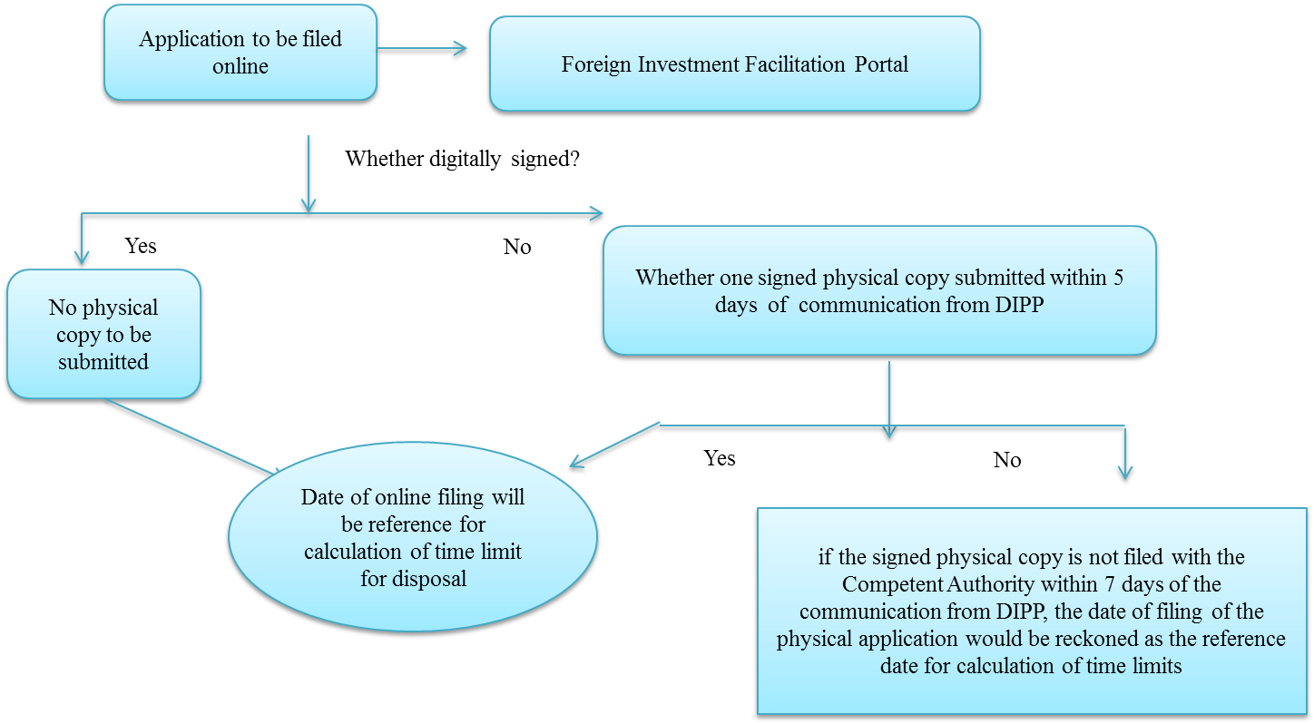
Procedure under Approval Route

Slide 15
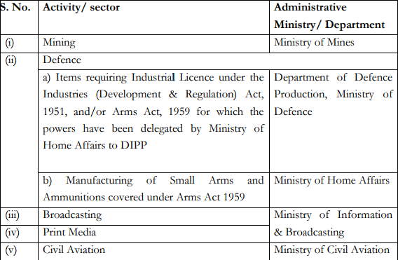
Competent Authorities

Slide 16
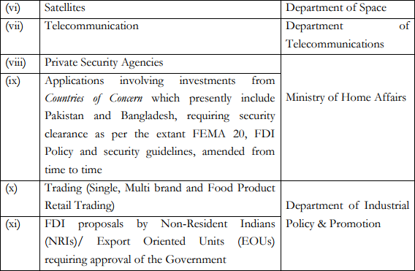
Competent Authorities

Slide 17
PROPOSALS REQUIRING SECURITY CLEARANCE
Broadcasting
Telecommunication
Satellites - establishment and operation
Private Security Agencies
Defence,
Civil Aviation and
Mining & mineral separation of titanium bearing minerals and ores, its value addition and integrated activities.
Investments from Pakistan and Bangladesh.
Security clearance and comments from Ministry of Home Affairs (MHA) within 6 weeks of online receipt of the proposal.
If not in position to revert in 6 weeks, will inform concerned administrative Ministry/Department of the expected time frame.

Slide 18
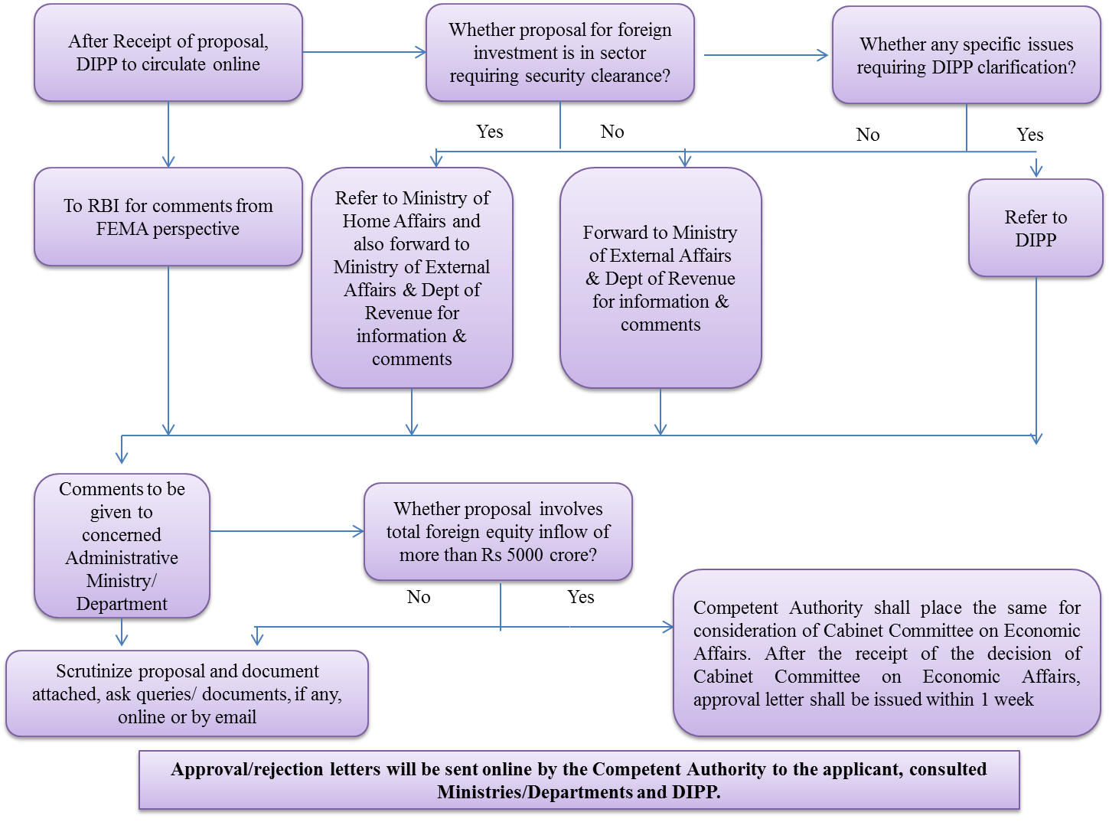

Slide 19
S. No. | TIMELINES FOR APPROVAL ACTION POINTS | Time Period | Cum. Time Period
1 | Dissemination of Investment Proposal by DIPP to Concerned Ministry/Department | 2 days | 1 Week
2 | Time for submission of signed physical copy of the proposal, if needed | 5 days
3 | Initial scrutiny of the proposal and documents attached therewith, and seeking relevant additional information/documents from the applicant | 1 Week | 2 Weeks
4 | Submission of clarification by DIPP on specific issues of FDI policy | 2 Weeks | 4 Weeks
5 | Submission of comments by Consulted Ministry/ Department/ RBI/ Any Other Stakeholder | 4 Weeks | 6 Weeks
6 | Submission of Comments by Ministry of Home Affairs on security clearance | 6 Weeks | 8 Weeks
7 | Approval on proposals by Competent Authority for grant of approval | 2 Weeks
 | Proposals not requiring security clearance |  | 8 Weeks
 | Proposal Requiring security clearance |  | 10 Weeks
Additional time of 2 weeks will be given to DIPP for consideration of those proposals which are proposed for rejection or where additional conditions which are not provided in the FDI policy are proposed to be imposed by the Competent Authority. Time limits allocated exclude the time taken by applicants in removing deficiencies in the proposals/supplying additional information as may be required by the Competent Authority.

Slide 20
EXPORT OF GOODS AND SERVICES
There is no restriction on invoicing of export contracts in Indian Rupees but export proceeds shall be realized in freely convertible currency.
The period of realization and repatriation of export proceeds shall be nine months from the date of export which can be extended by up to 15 months for exports made by SEZ, EOU, STP, EHTP and BTP. For goods exported to a warehouse established outside India, the proceeds shall be realized within fifteen months from the date of shipment of goods.
Banks can offer the facility of repatriation of export related remittances by entering into standing arrangements with Online Payment Gateway Service Providers (OPGSPs). This facility shall only be available for export of goods and services of value not exceeding USD 10,000.
Third party payments for export/import transactions can be made, subject to specified conditions. Firm irrevocable order backed by a tripartite agreement should be in place. Name of the third party need not be mentioned in the irrevocable order/invoice has been produced if AD bank is satisfied with the bona-fides of the transaction and export documents.
EXIM Bank and AD Category - I banks can undertake forfaiting, for financing of export receivables.
Export of machinery, equipment, etc., on lease, hire basis under agreement with the overseas lessee against collection of lease rentals/hire charges and ultimate re-import can be only with prior approval of RBI

Slide 21
EXPORT OF GOODS AND SERVICES
Exports on elongated credit terms can be only with prior approval of RBI.
Export of engineering goods on deferred payment terms and execution of turnkey projects and civil construction contracts abroad are collectively referred to as 'Project Exports‘. It requires approval of the AD Category - I banks/Exim Bank at post-award stage before undertaking execution of such contracts.
For long duration software export contracts involving series of transmissions, the exporters should bill their overseas clients periodically, i.e., at least once a month or on reaching the 'milestone' as provided in the contract entered into with the overseas client. Last invoice/bill should be raised not later than 15 days from the date of completion of the contract. Exporters can submit a combined SOFTEX form for all the invoices raised on a particular overseas client, including advance remittances received in a month. In case of Contracts involving only 'one-shot operation', the invoice/bill should be raised within 15 days from the date of transmission.
Where an exporter receives advance payment (with or without interest), from a buyer outside India, the exporter shall be under an obligation to ensure that the shipment of goods is made within one year from the date of receipt of advance payment.

Slide 22
EXPORT OF GOODS AND SERVICES
The rate of interest, if any, payable on the advance payment does not exceed London Inter-Bank Offered Rate (LIBOR) + 100 basis points; and the documents covering the shipment are routed through the AD Category - I bank through whom the advance payment is received.
If exporter is not able to make the shipment, partly or fully, within one year from the date of receipt of advance payment, no remittance towards refund of unutilized portion of advance payment or towards payment of interest, shall be made after the expiry of the said period of one year, without the prior approval of RBI.
AD Category- I banks can also allow exporters having a minimum of three years' satisfactory track record to receive long term export advance up to a maximum tenor of 10 years to be utilized for execution of long term supply contracts for export of goods subject to the specified condition
Exporters may approach AD Category - I banks for reduction in invoice value on account of cash discount to overseas buyers for prepayment of the usance bills.
If, after goods have been shipped, they are to be transferred to a buyer other than the original buyer in the event of default by the latter, it should be permitted by AD Bank, if the reduction in value does not exceed 25% of the invoice value and the realization of export proceeds is not delayed beyond the period of 9 months from the date of export. In other cases, approval of RBI is required.

Slide 23
EXPORT OF GOODS AND SERVICES
If exporter has not been able to realize the outstanding export dues despite best efforts, he may either self-write off or approach the AD Category - I banks, subject to following limits.
(a) Self "write-off" by an exporter (Other than Status Holder Exporter) - 5%
(b) Self "write-off" by Status Holder Exporters - 10%
(c) "Write-off" by Authorized Dealer Bank - 10%.
The above limits will be related to total export proceeds realized during the previous calendar year and will be cumulatively available in a year.
Conditions for write off - The above write-off will be subject to conditions that the relevant amount has remained outstanding for more than one year, satisfactory documentary evidence is furnished in support of the exporter having made all efforts to realize the dues, and the exporter should surrender proportionate export incentives, In case of self-write-off, the exporter should submit to the concerned AD bank, a Chartered Accountant's certificate, indicating the export realization in the preceding calendar year and also the amount of write-off already availed of during the year, if any, the relevant EDF to be written off, Bill No., invoice value, commodity exported, country of export and the export benefits, if any, availed of by the exporter have been surrendered.

Slide 24
EXPORT OF GOODS AND SERVICES
When write off not permissible - In following cases, the write off facility is not permissible - (a) Exports made to countries with externalization problem i.e. where the overseas buyer has deposited the value of export in local currency but the amount has not been allowed to be repatriated by the central banking authorities of the country (b) EDF which are under investigation by agencies like, Enforcement Directorate, Directorate of Revenue Intelligence, Central Bureau of Investigation, etc. (c) The outstanding bills which are subject matter of civil/criminal suit.
Reporting of write off - AD banks should report write off of export bills through EDPMS to RBI.
Permission of RBI in other cases - Cases not covered by the above instructions should be referred to the concerned Regional Office of RBI.
AD Category - I banks shall, on documentary evidence from the ECGC and private insurance companies confirming that the claim in respect of the outstanding bills has been settled by them, write off the relative export bills and delete them from the XOS statement. Such write-off will not be restricted to the limit of 10 per cent indicated above. Exporter should surrender export incentives. Such claims should not be construed as export realization in foreign exchange.

Slide 25
EXPORT OF GOODS AND SERVICES
Set off of export receivables against import payables is permissible in respect of the same overseas buyer and supplier and consent for set-off has been obtained from him. Both the transactions of sale and purchase may be reported separately in R-Returns and FETERS. The relative EDF will be released by the AD bank only after the entire export proceeds are adjusted/received.
AD Category - I banks, through whom the export proceeds were originally realized, can allow refund of export proceeds of goods exported from India and being re-imported into India on account of poor quality. They should exercise due diligence regarding the track record of the exporter.
In LIC v. Escorts Ltd. - AIR 1986 SC 1370 = (1986) 1 SCC 264 = (1986) 8 ECC 189 = (1986) 59 Comp Cas 548 (SC), it has been held that RBI is empowered to grant ex post facto permission under section 18(2). Thus, mere non-realisation of export proceeds will not amount to contravention of section 18(2) of FERA, unless RBI refuses permission to write off the receivables or to extend the period. Thus, Enforcement Directorate cannot take any action till application for permission is pending with RBI.

Slide 26
EXPORT OF GOODS AND SERVICES
Exporter will not be liable to penalty if he took reasonable steps for recovery, even if export proceeds are not realised. - M K Jain v. DD, ED (2002) 35 SCL 287 (ATFE).
Failure to take legal action against foreign buyer is not sole criteria for determining whether exporter has failed to take reasonable steps for realising export proceeds. - Northern Tannery v. Director of Enforcement (2005) 63 SCL 599 (ATFFE).
When company has filed suit in US Court and entire consignment has been covered under ECGC, no penalty can be imposed even if application for write off with RBI is pending - Samrat Ashok Exports v. Director of Enforcement (2004) 50 SCL 750 (ATFFE).
Even if RBI refuses the permission, exporter can prove that he had taken all reasonable steps to realise the proceeds and that the realisation remains outstanding in spite of such steps. If the exporter succeeds in proving this, he cannot be held guilty of contravention of section 18(2) of FERA - Taj Traders and Transport Co. Ltd. v. Director of Enforcement - (1995) 80 Taxman 103 (FERAB)
Burden of proof is on exporter to prove that he took all reasonable steps. If there are no reasonable prospects, he should approach RBI/authorised dealer for write off. Otherwise, penalty can be imposed. - Sharada Industries v. DD, ED (2002) 34 SCL 316 (ATFE).

Slide 27
IMPORT OF GOODS AND SERVICES
Where foreign exchange acquired has been utilised for import of goods into India, the AD Category - I bank should ensure that the importer furnishes evidence of import viz., Exchange Control Copy of the Bill of Entry, Postal Appraisal Form or Customs Assessment Certificate, etc., and satisfy himself that goods equivalent to the value of remittance have been imported.
Where imports are made in non-physical form, i.e., software or data through internet/datacom channels and drawings and designs through e-mail/fax, a certificate from a Chartered Accountant that the software/data/drawing/design has been received by the importer, may be obtained.
Remittances against imports should be completed not later than six months from the date of shipment, except in cases where amounts are withheld towards guarantee of performance, etc.
Settlement of import dues delayed due to disputes, financial difficulties, etc. may be permitted. However, interest if any, on such delayed payments, usance bills or overdue interest is payable only for a period of up to three years from the date of shipment and may be permitted in terms of RBI directions.
Deferred payment arrangements (including suppliers' and buyers' credit) upto five years, are treated as trade credits for which the procedural guidelines as laid down in the Master Circular for External Commercial Borrowings and Trade Credits should be followed.

Slide 28
IMPORT OF GOODS AND SERVICES
Payments can be made to a third party for import of goods, subject to firm irrevocable purchase order/tripartite agreement should be in place, except where documentary evidence for circumstances leading to third party payments/name of the third party is mentioned in the irrevocable order/invoice. AD bank should be satisfied with the bona fides of the transactions. The Invoice should contain a narration that the related payment has to be made to the (named) third party. Bill of Entry should mention the name of the shipper as also the narration that the related payment has to be made to the (named) third party.
AD Category – I bank may allow advance remittance if the amount of advance remittance exceeds USD 200,000 or its equivalent, an unconditional, irrevocable standby Letter of Credit or a guarantee from an international bank of repute situated outside India or a guarantee of an AD Category – I bank in India, if such a guarantee is issued against the counter-guarantee of an international bank of repute situated outside India, is obtained. If the importer is unable to obtain bank guarantee and the AD Category – I bank is satisfied about the track record and bonafides of the importer, the requirement of the bank guarantee / standby Letter of Credit may not be insisted upon for advance remittances up to USD 5,000,000 (US Dollar five million). AD Category – I banks may frame their own internal guidelines to deal with such cases as per a suitable policy framed by the bank's Board of Directors.

